Slide 1


Bankruptcy Prevention
TEAM 4

Slide 2
MENTORS
Himavanth Ila
Neha Ramchandani
TEAM MEMBERS
Ajeeth Kumar
Himmat Singh
Shazia Umar
Shubham Patidar
Shweta Kumbal

Slide 3




01 INDRODUCTION
02
EDA
03
MODEL BUILDING
04
DEPLOYMENT

Slide 4

01
INTRODUCTION

Slide 5

BUSINESS OBJECTIVE
Our business objective is to predict the
Bankruptcy Prevention based on the
attributes available

Slide 6
ABSTRACT
This Project discuss bankruptcy-related problems such as measuring bankruptcy costs and predicting bankruptcies. The magnitude of bankruptcy costs is a critical issue in terms of capital structure theories. It has also crucial importance to predict probability of bankruptcy in the assessment of companies’ creditworthiness.
The enormous increase in large corporate failures in the last decades has revealed the importance of bankruptcy prediction and enforced to improve new techniques.
The keystone studies of bankruptcy literature, different findings and views regarding problematic issues of bankruptcy are presented in this Project.
The inconclusive results of these studies indicate that bankruptcy will remain an attractive field for all parties of financial world.

Slide 7
ATTRIBUTES GIVEN IN THE DATA SET
Industrial Risk
Management Risk
Financial Flexibility
Credibility
Competitiveness
Operating Risk
Class yn

Slide 8

02
EDA

Slide 9

In the EDA, we analysed the relation between the attributes by finding the correlation between them and visualising it by using various plots like box plot, histogram, Correlation Map in order to select the best features which satisfies the regression assumptions to propose the best fitting curve for the prediction.

Slide 10
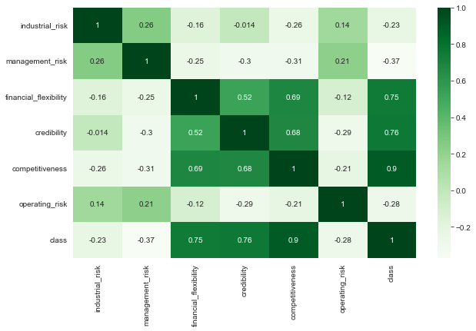
CORRELATION MAP

Slide 11
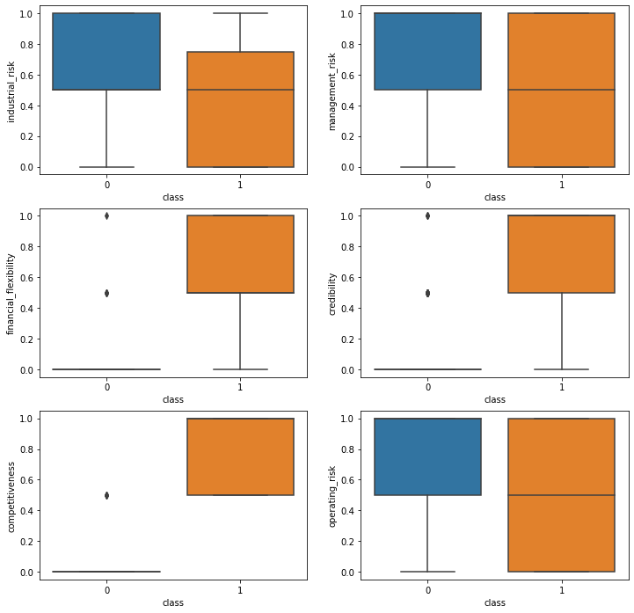
BOX PLOTS

Slide 12
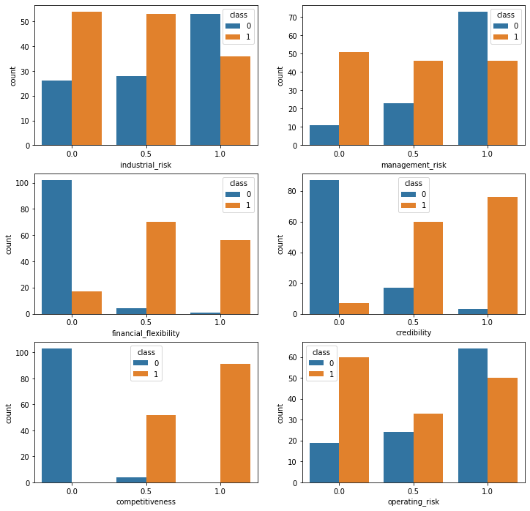
COUNT PLOTS

Slide 13
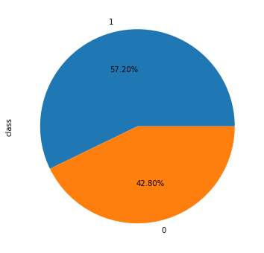
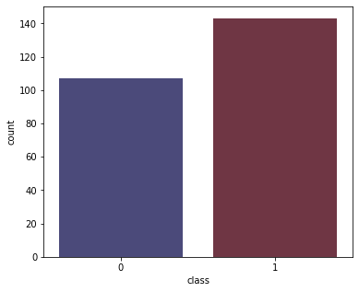
Count plot For Class
Pie Chart For Class

Slide 14
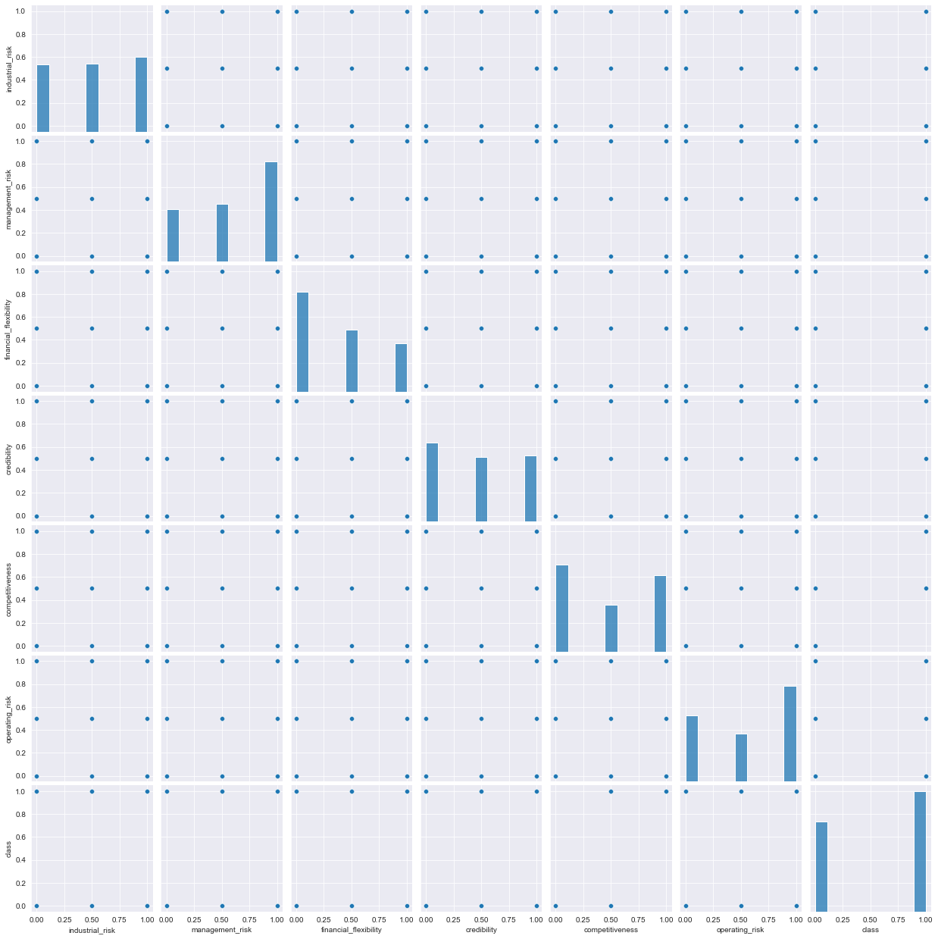
Pair Plot

Slide 15

03
MODEL BUILDING

Slide 16
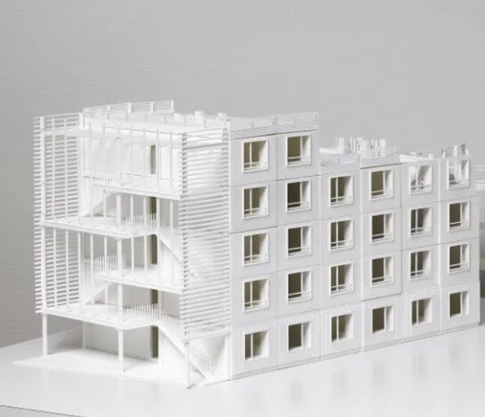
MODEL BUILDING
In the Model Building we built different regression models such as Logistic Regression, Naive Bayes, KNN, Random Forest, Decision Tree, Support Vector Machine, XGBoost, CatBoost and selected the best fitting model which has high accuracy rate.

Slide 17

Regression Models
Model 1
Logistic Regression:
Logistic Regression got the Accuracy of 100.00%
Model 2
Naive Bayes:
Naïve Bayes got the Accuracy of 100.00%
Model 3
KNN:
KNN got the Accuracy of 98.41%
Model 4
Random Forest:
Random Forest got the Accuracy of 98.41%

Slide 18
Model 5
Decision Tree:
Decision Tree got the Accuracy of 100.00%
Model 6
Support Vector Machine:
Support Vector Machine got the Accuracy of 100.00%
Model 7
XG Boost:
XG Boost got the Accuracy of 100.00%
Model 8
Cat Boost:
Cat Boost got the Accuracy of 100.00%

Slide 19
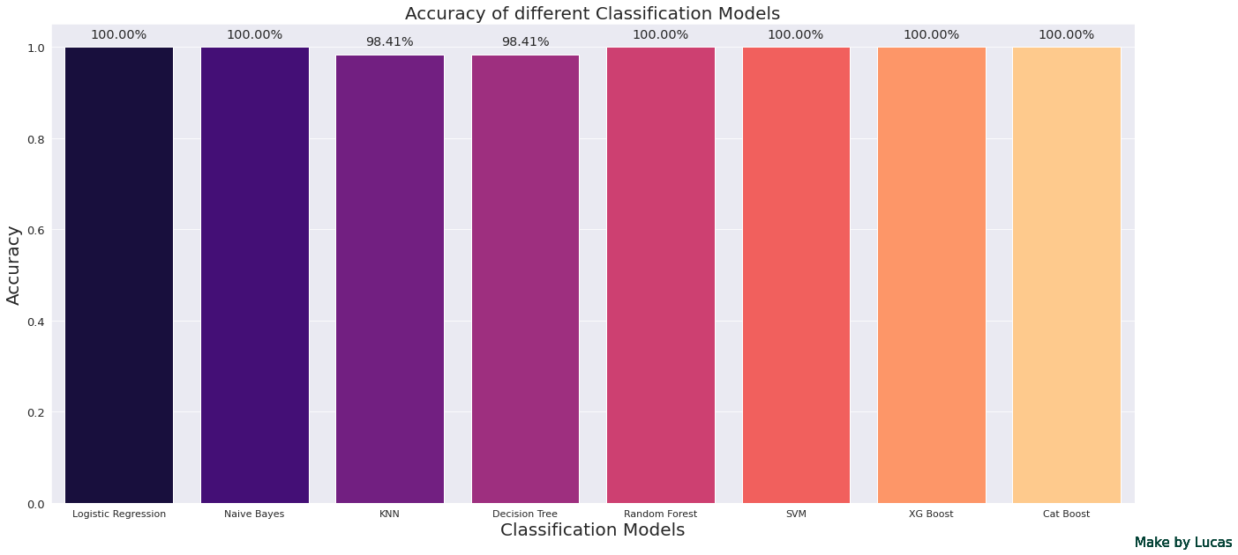
Accuracies Of Different Classification Models

Slide 20

Logistic regression, Naive Bayes, Random Forest, SVM, XG Boost, Cat Boost are the best fitting Models with the Accuracy of 100.00 %

Slide 21

04
DEPLOYMENT

Slide 22
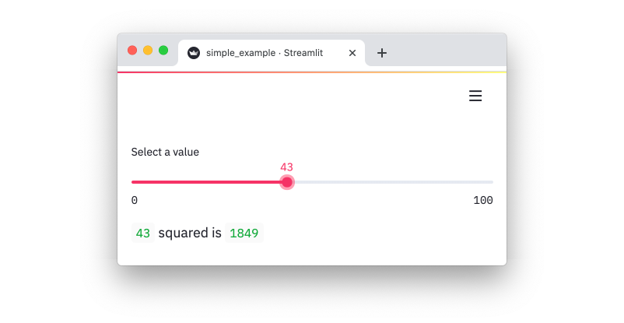
DEPLOYMENT USING STREAMLIT
Deployment is the process of placing a finished machine learning model into a live environment where it can be used for its intended purpose. Here we deployed the Model using Stream lit.

Slide 23
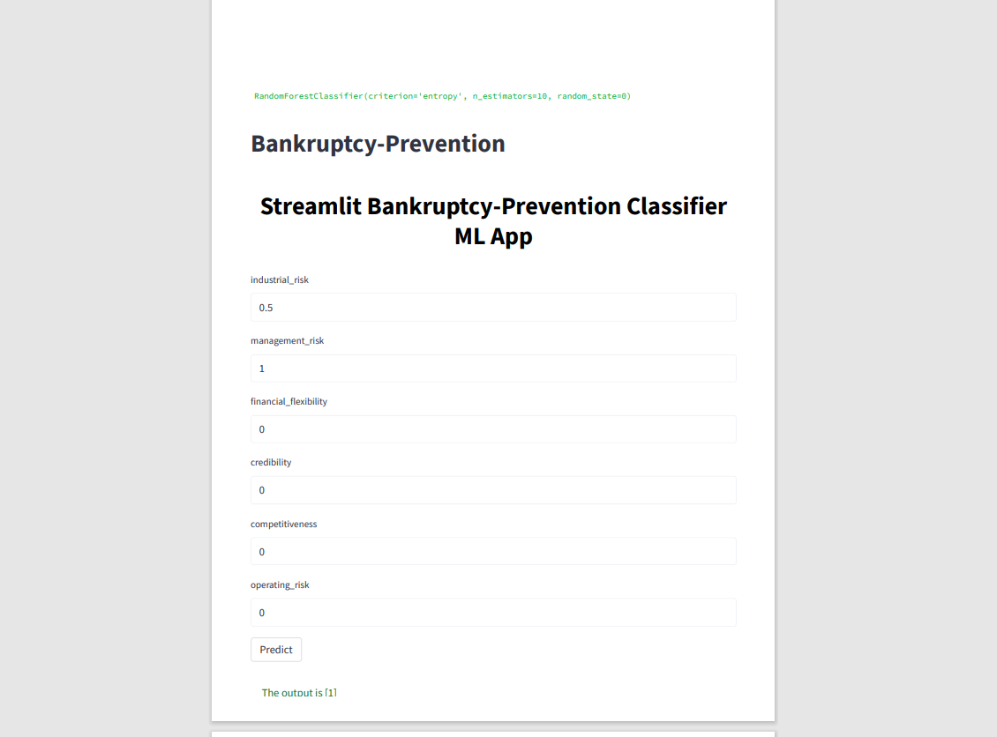
OUTPUT

Slide 24

CHALLENGES FACED!
In the data Visualization part it took time to display pair plot.
In the Model building part it took a lot of time to run the Models
In the Deployment part we got errors which says ‘Module not
found’. Then we used Stream lit to create a virtual Environment.

Slide 25
THANK YOU!!

